Slide 1
Neonatal Intestinal Obstruction
Dr/ Nabil Abou-eldahab
Professor of Pediatric surgery

Slide 2
Introduction
Neonatal intestinal obstruction is the most common neonatal surgical emergency
Successful management of depends on timely diagnosis and referral for therapy.

Slide 3
Incidence
About 1 in 2000 live births

Slide 4
Causes
Can be classified according to various categories

Slide 5
According to anatomy ( level )
High Intestinal Obstruction
Duodenal obstruction
Duodenal atresia
Annular pancreas
Malrotation with lads band
2. Jejunal atresia
Low Intestinal Obstruction
Ileal atresia
Meconium ileus
meconium plug or small left colon syndrome
Hirschsprung’s disease
Ano-rectal malformation

Slide 6
According to pathology
Intraluminal
e.g. atresia & meconium ileus
Extraluminal
Ladd’s band
Functional
Hirshsprung’s disease

Slide 7
Cardinal signs for diagnosis
Maternal polyhydraminos
Bilious vomiting
Failure to pass meconium in first day of life
Abdominal distention

Slide 8
Other diagnostic criteria
Colic: manifest in baby by crying and withdraw of leg
Visible peristalsis
Dehydration

Slide 9
Management:
A. First aid:
1. Insertion :
Nasogastric tube, I.V. access & urinary catheter
2. Fluid and drugs:
Ringer lactate solution 10-20 ml/kg & is repeated according to degree of dehydration
Antibiotics
3. Management of electrolytes disturbance

Slide 10
B. Confirm diagnosis:
1. Plain X ray abdomen: (first & most important investigation)
❶ Confirm the diagnosis: detects multiple fluid levels
❷ It helps to identify the causes of obstruction: e.g.
1. Double bubble sign: in duodenal obstruction
2. Free air in peritoneum: in intestinal perforation
3. Intramural gas: in necrotizing enterocolitis
4. Invertogram for anorectal anomalies
2. Others investigation according to causes

Slide 11
Duodenal obstruction

Slide 12
Aeitology
Intrinsic
Duodenal atresia,
Duodenal stenosis
Duodenal diaphragm
2. Extrinsic
Annular pancreas
Malrotation with Ladd's band
preduodenal portal vein

Slide 13
Associated anomalies ( common with artesia)
Down syndrome (>30%),
malrotation
congenital heart diseases

Slide 14
Diagnosis
Prenatal:
polyhydramnios
Postnatal
1. Early vomiting mostly bilious (as obstruction mostly distal to ampulla of Vater)
2. Minimal abdominal distention (in epigastrium)
3. Dehydration and electrolyte depletion
4. The diagnosis may be delayed in partial obstruction

Slide 15
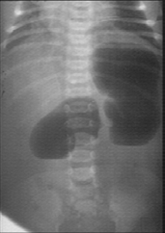
Investigation
1. Plain X-ray abdomen:
Double bubble sign: only two fluid levels in stomach & duodenum
2. Upper gastrointestinal contrast
In cases of incomplete obstruction

Slide 16
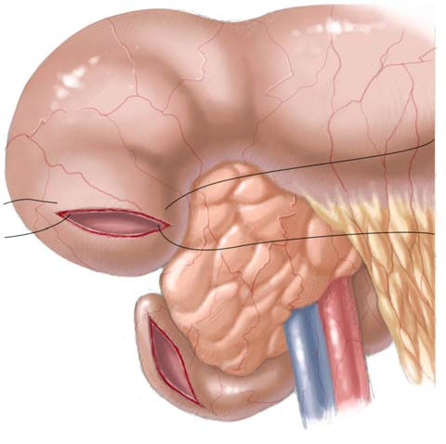
Treatment
Duodenoduodenostomy either
side-to-side duodenoduodenostomy
or diamond-anastmosis proximal transverse to distal longitudinal
Division of Ladd's
band

Slide 17
Volvulus neonatorum

Slide 18
Embryological review
✦ In embryo, the growth of intestine is faster than the abdominal cavity
✦ Thus herniation of intestine in umbilical cord at about 4th to 6th weeks of gestation (physiological hernia)
✦ At 10 – 12 weeks, the bowel returns to the abdomen with rotation
✦ Then intestine undergoes rotation in anticlockwise direction

Slide 19
Embryological review
The rotation occurs in three stages
1. First stage: 90 degree rotation
The small intestine to the right and the colon to the left
2. Second stage: further 180 degree rotation
The small intestine to the left of the abdomen and the caecum below the liver
3. Third stage:
Descend and fixation of caecum and ascending colon to posterior abdominal wall

Slide 20
Aeitology & pathology
Failure of rotation
✦ The mid gut has a narrow based mesentery
✦ The intestine liable to twist around its mesentery  volvulus strangulation obstruction of whole midgut
Incomplete rotation
✦ The caecum lies in epigastrium
✦ Fibrous bands (Ladd’s band) run from incompletely descended caecum across second part of duodenum  obstruction of duodenum

Slide 21
Clinical picture
Acute obstruction due to Ladd’s bands or intermittent midgut volvulus :
bilious vomiting
colicky abdominal pain and abdominal distention.
Picture of strangulation obstruction in midgut volvulus
abdominal tenderness & rigidity
bleeding per rectum

Slide 22
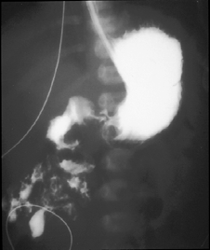
Investigations
Plain X ray :
Double bubble sign in
Ladd’s band
Contrast study:
low or medial position of the duodenojejunal junction
spiral “corkscrew” or Z-shaped course of the duodenum and proximal jejunum
location of the proximal jejunum in the right abdomen.

Slide 23
Treatment
It is urgent condition
Especially in doubtful of ischemia
First aid :
Fluid therapy and Ryle

Slide 24
Surgical maneuver
Entire bowel and mesenteric root are inspected.
Any volvulus should be derotated anticlockwise
Division of Ladd’s bands
Appendectomy
Placement of the caecum in the left lower quadrant

Slide 25
Intestinal atresia & stenosis

Slide 26
Etiology
Mostly result from a localized intra-uterine vascular insult ischaemic necrosis

Slide 27
C.P.
Maternal polyhydraminos
Bilious vomiting {large intragastric volumes
at birth (>20 ml gastric aspirate) }
Abdominal distention : more distal the obstruction the more abdominal distension

Slide 28
Investigation
X ray
High jejuneal atresia: Few air fluid level
2. Lower atresia: More fluid level
Contrast enema
Microcolon ( non used colon)

Slide 29
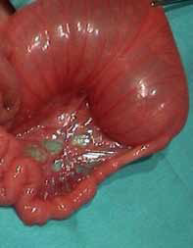
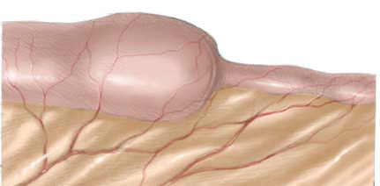
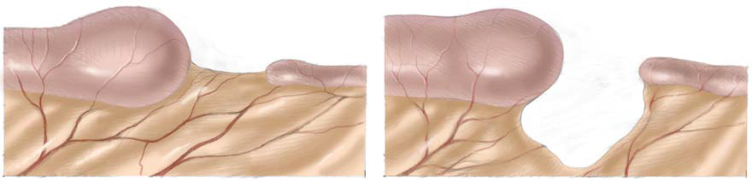
Pathological types
↑ 90 % of cases are single
Type I:
intra-luminal diaphragm
Type II:
Atresia with cord like segment between blind ends of bowel

Slide 30
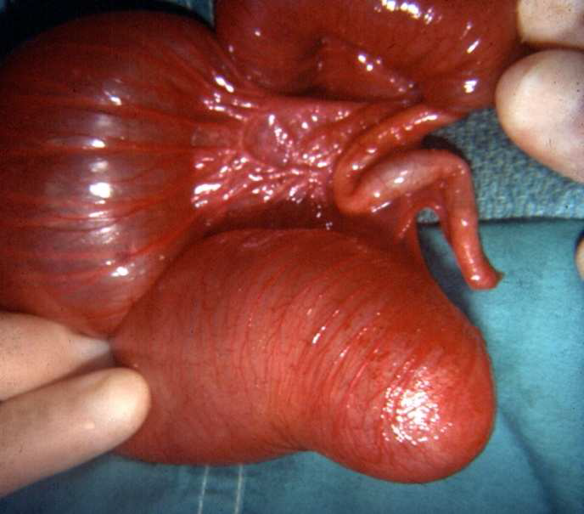
Pathological types
Type IIIa:
Atresia with complete separation of the blind bends of the bowel by V shaped mesenteric defect

Slide 31
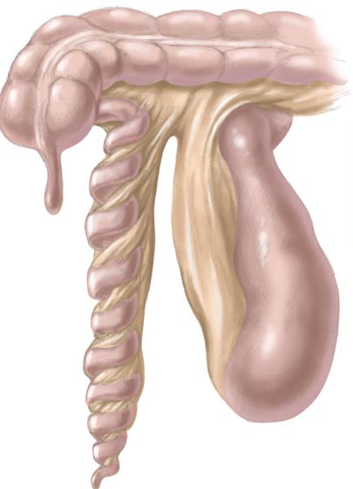
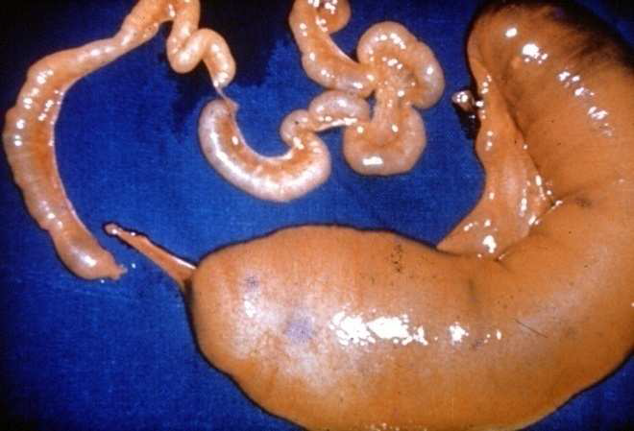
Pathological types
Type IIIb: (“apple peel” or “Christmas tree” deformity)
The bowel receive retrograde blood supply from ileocolic
Type IV:
Multiple atresias

Slide 32
Surgical treatment
Confirmation of patency of distal bowel with saline
Resection of the proximal distended atretic segment.
Volvulated bowel must be untwisted carefully, especially in type III(b) atresia.
Limited distal bowel resection.

Slide 33
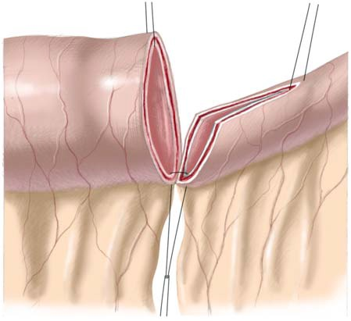
Surgical treatment
. End to oblique anastmosis .

Slide 34
Meconium ileus

Slide 35
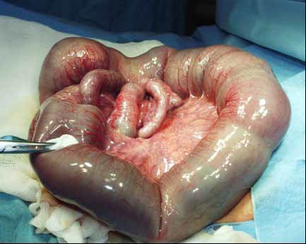
Introduction
bowel obstruction by meconium ( thick inspissated and viscid mucus of intestinal origin ) in distal ileum
Meconium ileus
is the earliest
clinical
manifestation
of cystic fibrosis
(CF)

Slide 36
Clinical pictures
Uncomplicated type
abdominal distension
bilious vomiting
delayed passage of meconium
Dilated distended loops may be palpable

Slide 37
Clinical pictures
Complicated type:
Serious condition presented early by
Associated with volvulus, perforation, or atresia,
Massive distention,
Erythema of abdominal wall .
no bowel sounds

Slide 38
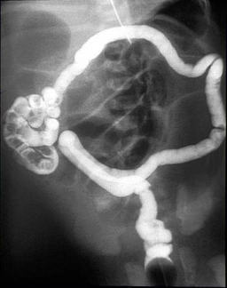
Investigations
X ray :
Ground-glass or soap-bubble appearance due to a dense meconium mixed with air:
Calcification in case of meconium peritonitis as result of perforation
Contrast enema :
Micro-colon ( non used colon)

Slide 39
Treatment
Non-operative Treatment
In uncomplicated case.
Before trial of treatment :
oral gastric tube decompression;
intravenous fluids to replace deficits and compensate losses;
Correction of the acid-base balance.

Slide 40
Treatment
Steps of treatment
gastrografin enema ( can be accompanied by use of N-acetylcysteine)
The enema draw large volumes of fluid into lumen.
Therefore, the child must be well-rehydrated prior to this procedure.
Procedure must be under fluoroscopic control
patient should evacuate spontaneously over the next 6–8 hours.

Slide 41
Treatment
Operative treatment
Indication :
failure of non operative or complicated case
Three procedures can be used:
1. enterostomy and decompression;
2. Resection and stoma formation; or
3. resection and anastomosis.

Slide 42
Treatment
Enterostomy and decompression;
Enterostomy is performed and the sticky meconium is washed out by using gastrografin or a 1:5 solution of acetylcysteine/saline.

Slide 43
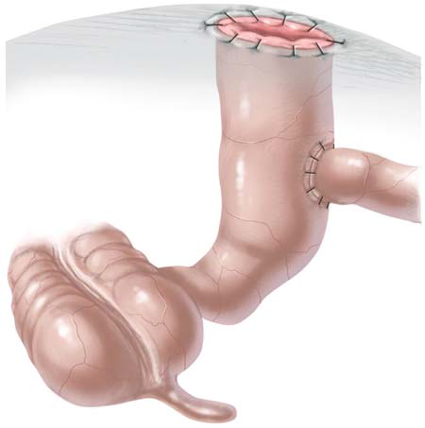
Treatment
Resection and stoma formation:
Bishop-Koop
Roux-en-Y anastomosis between the end of the proximal segment and the side of the distal segment, at least 3 to 5 cm from the open end.  The open limb of the distal segment is used as an ileostomy

Slide 44


